Slide 1

Domestic Travel US
By Aanchal Saxena, Giovanna Bendana, Kavi Gill, Sahil Wadhwa
Notes:
Sahil

Slide 2
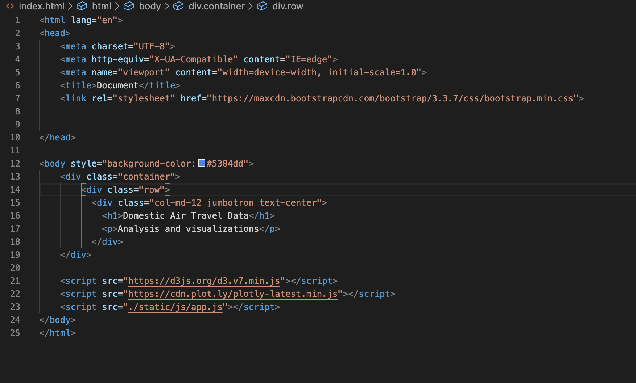
Backend
Notes:
Kavi

Slide 3
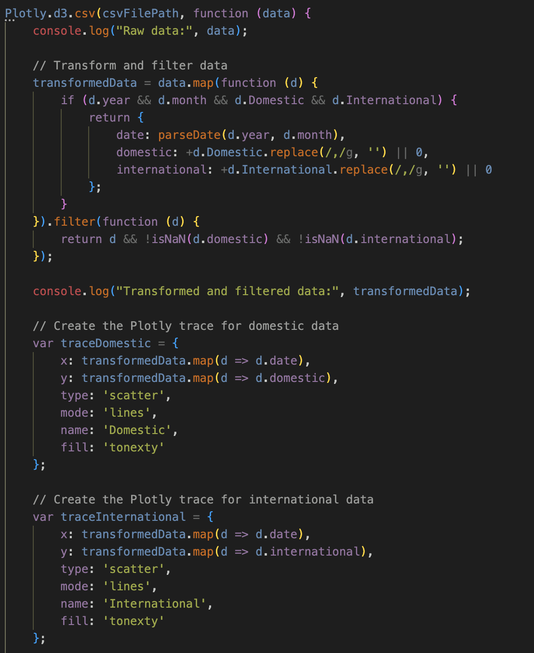

Stacked Area Chart Using Plotly
Notes:
Aanchal

Slide 4

Demo of stacked area chart

Slide 5
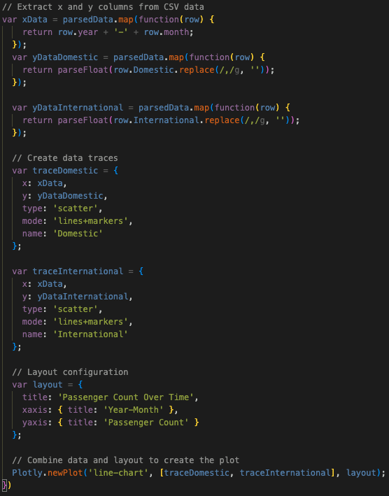
Line Plot using Plotly
Notes:
Aanchal

Slide 6
Demo for Line Graph
Notes:
Aanchal

Slide 7
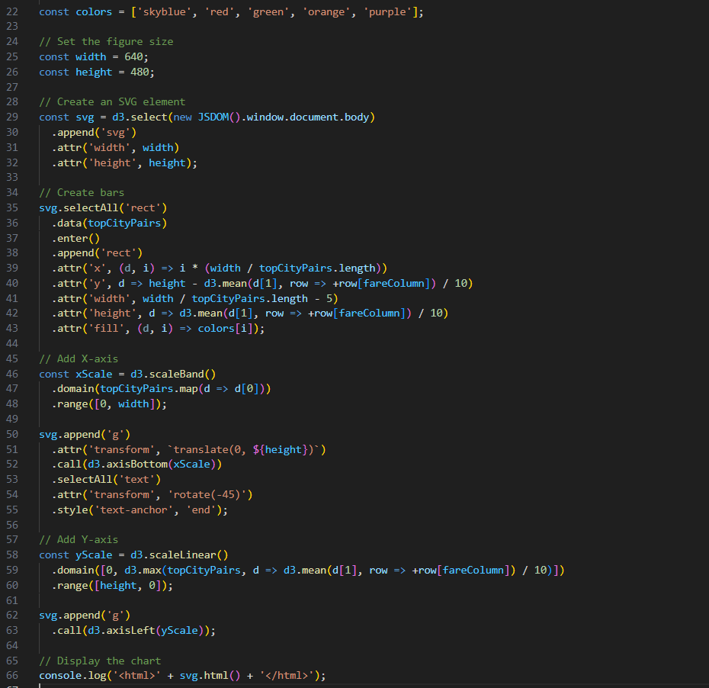
Bar Chart for Highest Air Fare cost by city pair
Notes:
Giovanna

Slide 8
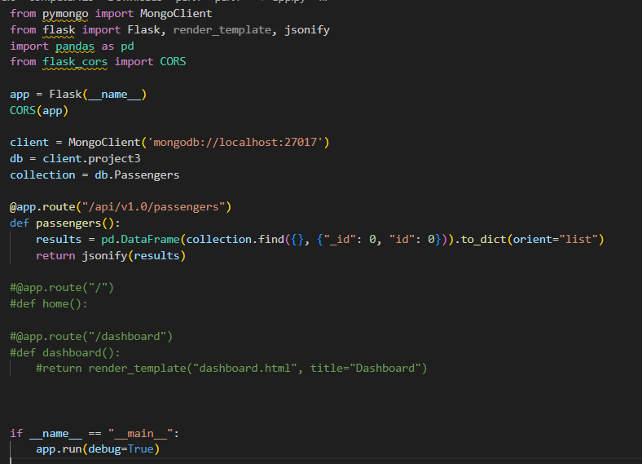
Flask

Slide 9
Tools Used
-HTML
-CSS
-Javascript
-Flask API
-MongoDB (NoSQL)
-PyMongo
Notes:
Sahil

Slide 10
Thanks for Watching! Any questions?

